Slide 1
MIDBS CIA 3
Hemanath Kumar (21121015)

Slide 2
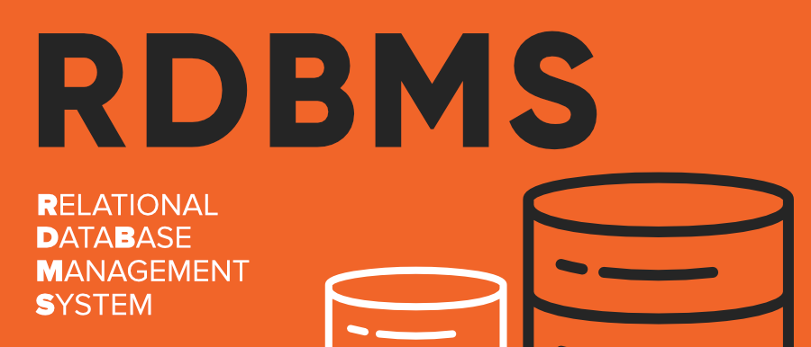
What is rdbms?
An RDBMS, or relational database management system, is the software that gives users the ability to update, query and administer a relational database.
Structured Query Language (SQL) is typically the standard programming language used to access the database.
It has the following major components: Table, Record/Tuple/Row, Field, and Column/Attribute.
E.g. MYSQL, Oracle, IBM DB2, and Microsoft SQL Server database.

Slide 3
Features of RDBMS
All data stored in the tables are provided by an RDBMS
Ensures that all data stored are in the form of rows and columns
Facilitates primary key, which helps in unique identification of the rows
Index creation for retrieving data at a higher speed
Facilitates a common column to be shared amid two or more tables
Multi-user accessibility is facilitated to be controlled by individual users
A virtual table creation is enabled to store sensitive data and simplify queries

Slide 4
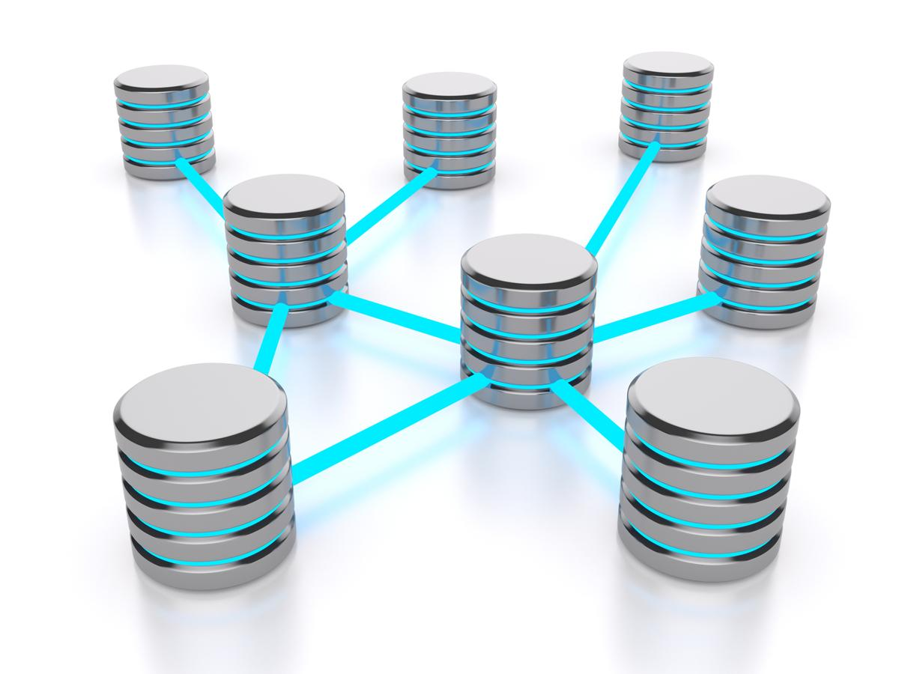
Advantages of RDBMS
Data structure:
Accessing the Network:
Language:
Speed
Maintenance
User Access to More Than One Person
Privileges

Slide 5
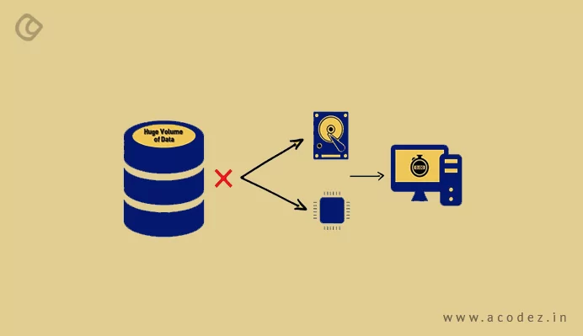
Disadvantages of RDBMS
Cost
Managing Huge Volumes of Data
Structured Limits

Slide 6
Training management system
Training management process includes managing and maintaining training records of any organization.
A TMS manages back-office processes for corporate instructor-led-training administration, and typically handles session registration, course administration, tracking, effective monitoring and reporting.
A training management system is a streamlined version of what you already do on a daily basis to manage your training organization.

Slide 7
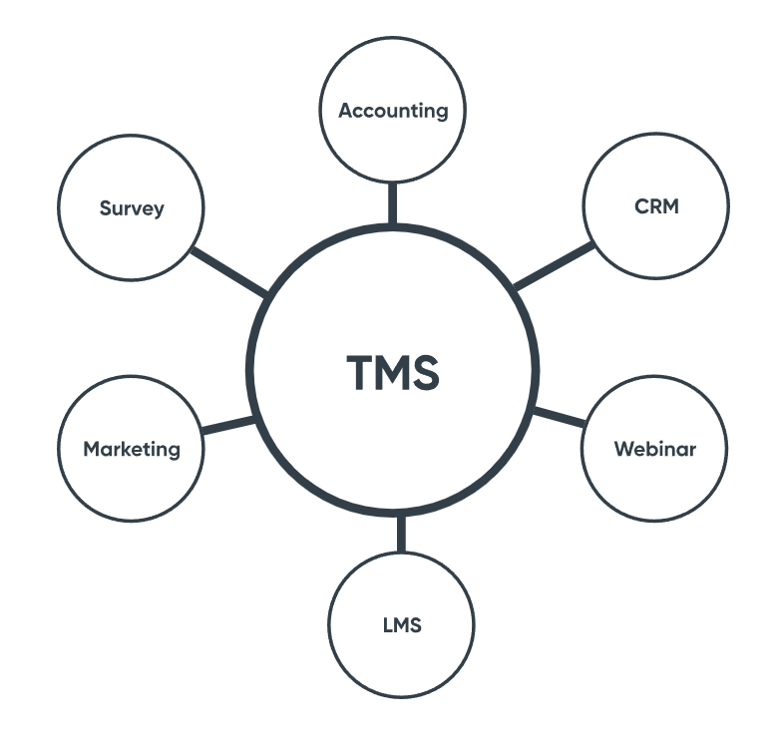
Features of tms
Back-office Administration Features
Front-of-house Features
Organise course logistics and resources.
Automate manual tasks.
Manage finances.
Reports and business intelligence.
Website.
Online registration.
Customer portal.

Slide 8
DIFFERENT VENDORS OF TMS
From India: TalentLMS, UpsideLMS, HRMantra, Pocket studyLMS, WiZDOM LMS
From other Countries: Trainual, TalentLMS, LearnUpon LMS, PowerDMS, Tovuti LMS

Slide 9
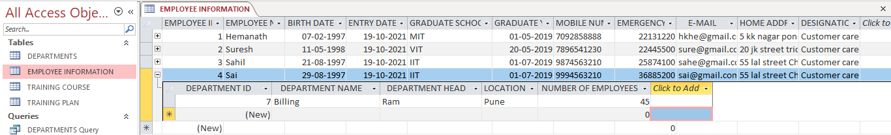
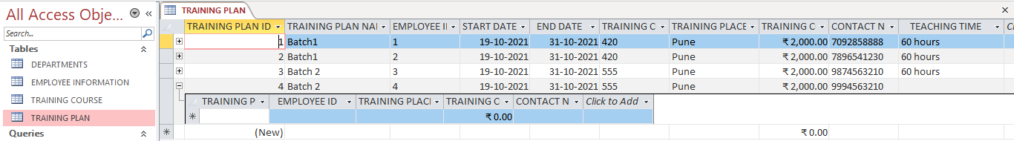
Training management system – access
Table →

Slide 10
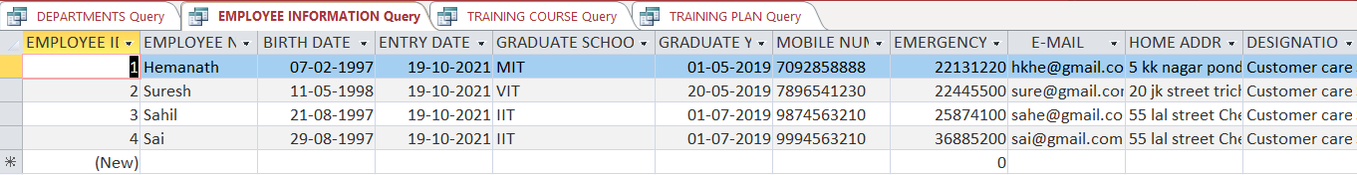
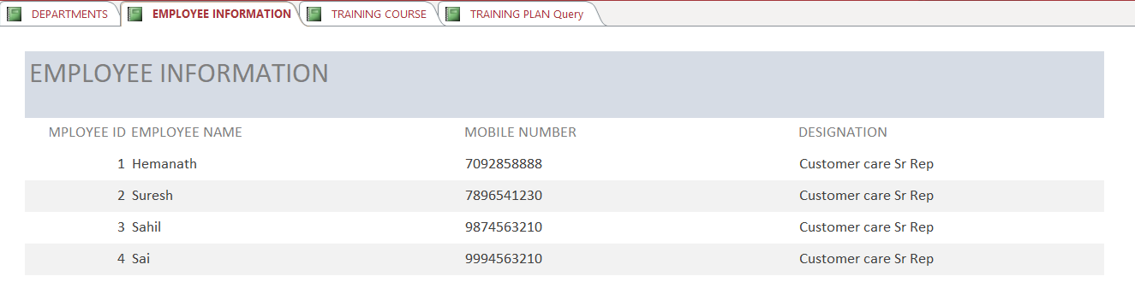
Training management system – access
Query →
Reports →

Slide 11
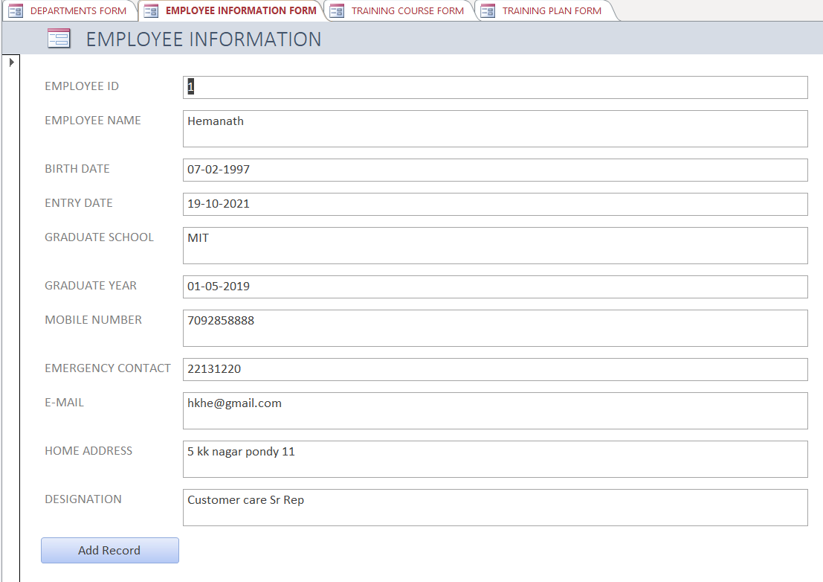
Training management system – access
Forms→

Slide 12
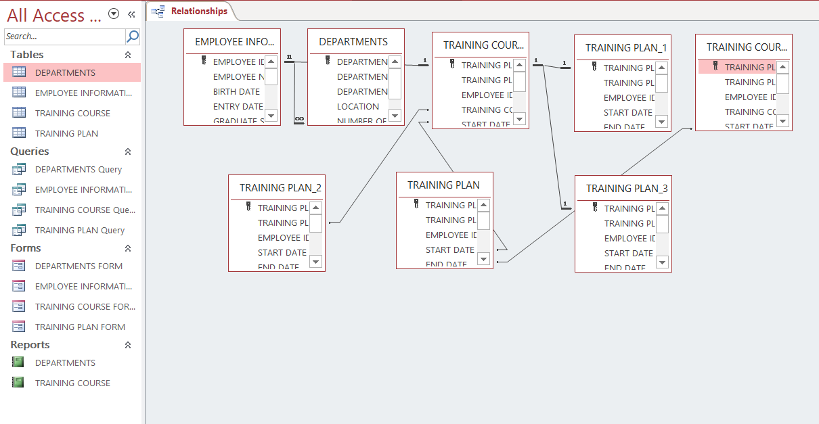
Training management system – access
Relationships→

Slide 13
Conclusion
A database is a far more efficient mechanism to store and organize data than spreadsheets.
It allows for a centralized facility that can easily be modified and quickly shared among multiple users.
The RDBMS provides an interface between users and applications and the database, as well as administrative functions for managing data storage, access, and performance.
A DBMS is a systematic operational system which consists of toolmaking data, data saving and data manipulation an easier task. DBMS is the majorly used through out the world for data handling.
Thus, its a good data manager till today.

Slide 14


